Slide 1
Capstone Project
NYC Taxi Trip Duration Analysis and Prediction
By
Rushabh Anilrao Bhagat
Data Science Trainee, AlmaBetter

Slide 2

Content:
Introduction
Problem Statement
Data Description
Exploratory Data Analysis
Passengers
Distance
Speed
Feature Engineering
Dropping Unwanted columns
Linear Regression
Decision Tree
Random Forest
Recommended Approach
Conclusion

Slide 3

Introduction
The dataset is based on the 2016 NYC Yellow Cab trip record data made available in Big Query on Google Cloud Platform. The data was originally published by the NYC Taxi and Limousine Commission (TLC). The data was sampled and cleaned for the purposes of this project. Based on individual trip attributes, you should predict the duration of each trip in the test set. NYC Taxi Data.csv - the training set (contains 1458644 trip records).
Business Objective/ Probleam statement
Build a model that predicts the total trip duration of taxi trips in New York City.
In this project, you are required to do
Exploratory Data Analysis
Understanding different Trips do daily in taxi.
Apply Machine Learning algorithm and check which is better.

Slide 4
Data Description
Id - A unique identifier for each trip.
vendor_id - a code indicating the provider associated with the trip record.
pickup_datetime - date and time when the meter was engaged.
dropoff_datetime - date and time when the meter was disengaged.
passenger_count - the number of passengers in the vehicle (driver entered value).
pickup_longitude - the longitude where the meter was engaged.
pickup_latitude - the latitude where the meter was engaged.
dropoff_longitude - the longitude where the meter was disengaged.
dropoff_latitude - the latitude where the meter was disengaged.
store_and_fwd_flag - This flag indicates whether the trip record was held in vehicle memory before sending to the vendor because the vehicle did not have a connection to the server - Y=store and forward; N=not a store and forward trip.
trip_duration - duration of the trip in seconds.

Slide 5
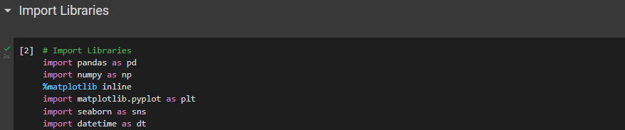
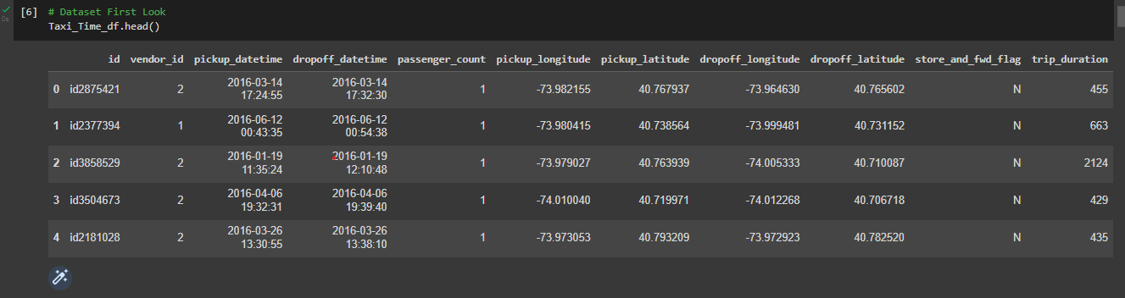
Data Preparation and EDA
First, begin with setting our path and importing required packages.
Now, Let’s read our dataset, we have some good amount of features in it.

Slide 6
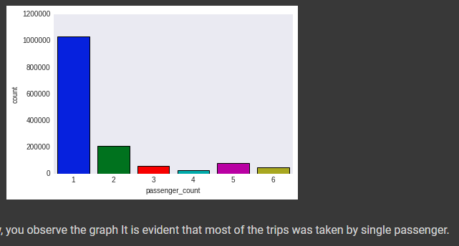
Passengers
New York City Taxi Passenger Limit says:
A maximum of 4 passengers can ride in traditional cabs, there are also 5 passenger cabs that look more like minivans.
A child under 7 is allowed to sit on a passenger's lap in the rear seat in addition to the passenger limit. So, in total we can assume that maximum 6 passenger can board the new York taxi i.e. 5 adult + 1 minor

Slide 7
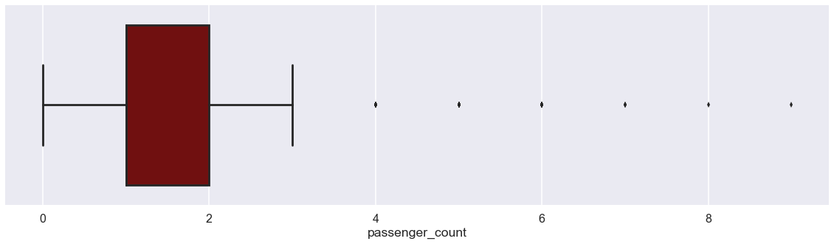
Most number of trips are done by single or double passengers.
But one thing is Interesting to observe, there exist trip with ZERO passengers, was that a free ride ? Or just a False data recorded ?

Slide 8
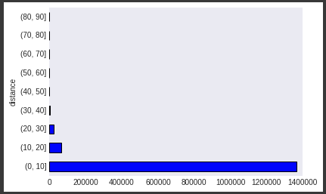
Distance
Around 6K trip record with distance equal to 0. Below are some possible explanation for such records.
Customer changed mind and cancelled the journey just after accepting it.
Software did not recorded dropoff location properly due to which dropoff location is the same as the pickup location.
Issue with GPS tracker while the journey is being finished.
Driver cancelled the trip just after accepting it due to some reason. So the trip couldn't start Or some other issue with the software itself which a technical guy can explain There is some serious inconsistencies in the data where drop off location is same as the pickup location.

Slide 9
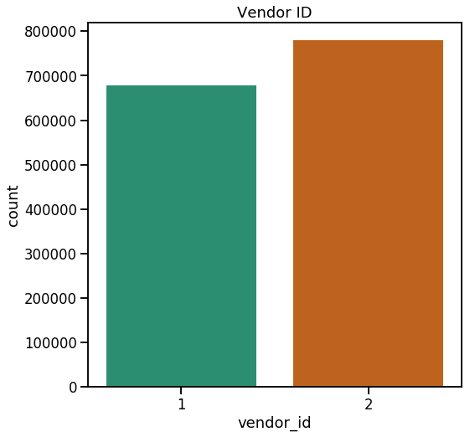
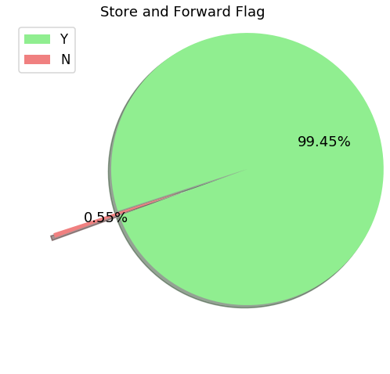
Now, we will perform basic EDA to get some insights into the data.
Vendor_ID stating the provider associated with trip, preferably 2 different taxi companies.
Analysis tells us that Second service provider has been most frequently famous by people over First service provider over the period of time.
We have almost all the trip records sent to the server.

Slide 10
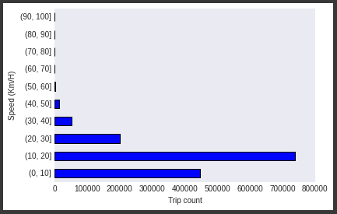
Speed of a car
25 mph in urban area i.e. 40 km/h 65 mph on controlled state highways i.e. approx 104 km/h.
Trips over 30 km/h are being considered as outliers but we cannot ignore them because they are well under the highest speed limit of 104 km/h on state controlled highways. Mostly trips are done at a speed range of 10-20 km/h with an average speed of around 14 km/h. Let's take a look at the speed range distribution with the help of graph.
It is evident from this graph what we thought off earlier i.e. most of the trips were done at a speed range of 10-20 km/h.

Slide 11
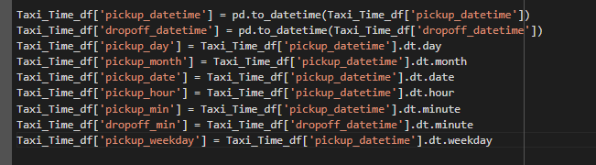
Feature Engineering
Label Encoding Categorical Variables ,i.e. “store_and_fwd_flag” and “vendor_id”. We can convert these features into “category” type by function called “astype(‘category’)” that will speed up the Computation.
The Date and time columns in the Dataset has whole lot story to tell, we have to fetch them as separate columns. We do not have to fetch pickup and drop-off time both, as they may lead to strong positive correlation in the respective fetched features. Further we can use these columns for Analysis.

Slide 12
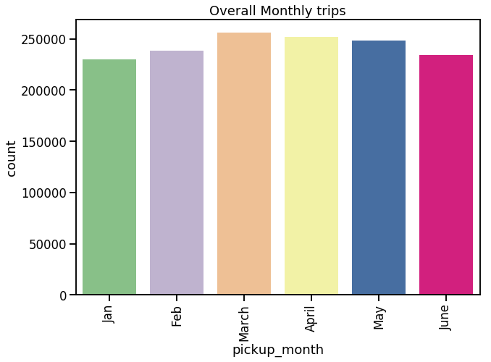
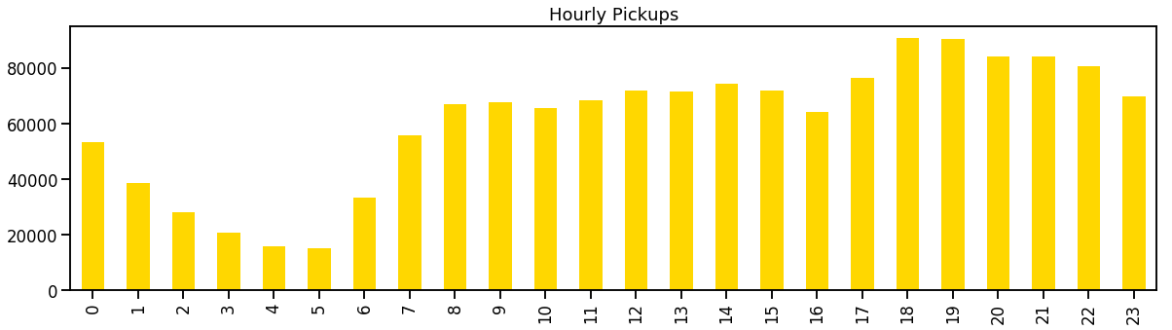
Number of trips in a particular month - March and April marking the highest. January being lowest maybe due to SnowFall.
In which hour we get to see maximum trips ? - Rush hours (5pm to 10pm)

Slide 13
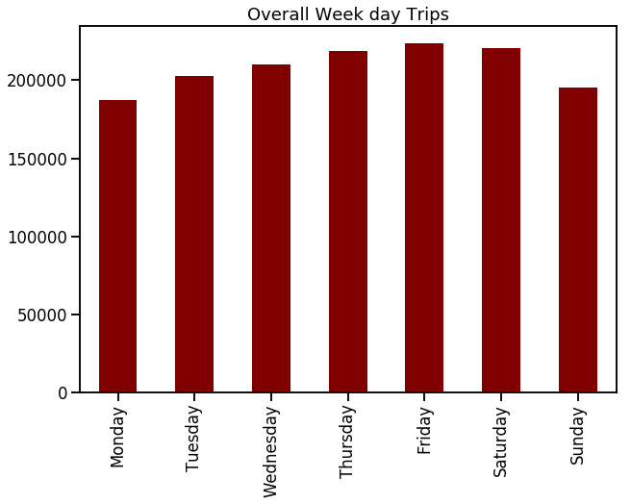
Observations says that Fridays and Saturdays are those days in a week when New Yorkers prefer to Rome in city. GREAT !!

Slide 14
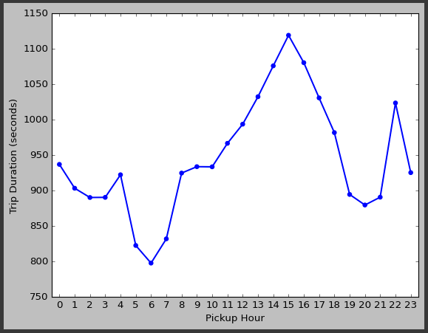
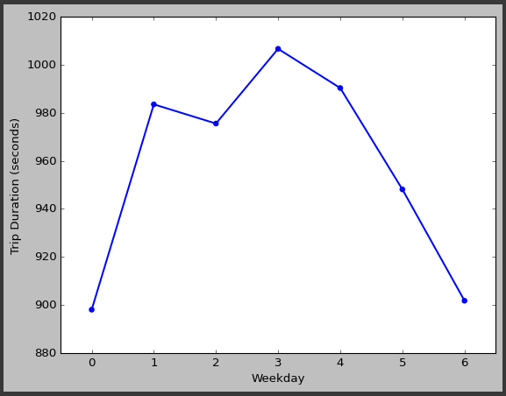
Trip Duration
1. Trip Duration per Hours.
Average trip duration is lowest at 6 AM when there is minimal traffic on the roads.
Average trip duration is generally highest around 3 PM during the busy streets.
Trip duration on an average is similar during early morning hours i.e. before 6 AM & late evening hours i.e. after 6 PM.
2. Trip Duration per Weekday.
We can see that trip duration is almost equally distributed across the week on a scale of 0-1000 minutes with minimal difference in the duration times. Also, it is observed that trip duration on Thursday is longest among all days.

Slide 15
3. Trip Duration per Month.
We can see an increasing trend in the average trip duration along with each subsequent month.
The duration difference between each month is not much. It has increased gradually over a period of 6 months.
It is lowest during February when winters starts declining.
There might be some seasonal parameters like wind/rain which can be a factor of this gradual increase in trip duration over a period.

Slide 16
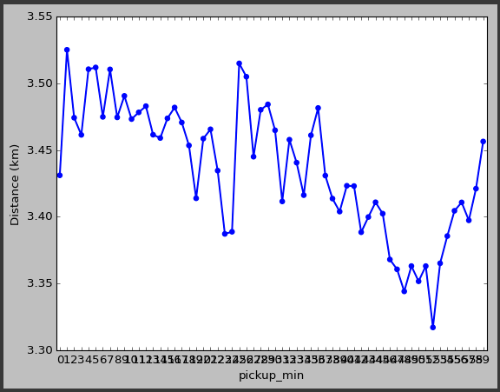
Distance
Distance per Minute
Outstation trips taken during the weekends.
Longer trips towards the city airport which is located in the outstation of the city.
Trip distance is fairly equal from morning till the evening varying around 3 - 3.5 kms.
It starts increasing gradually towards the late night hours starting from evening till 5 AM and decrease steeply towards morning.

Slide 17
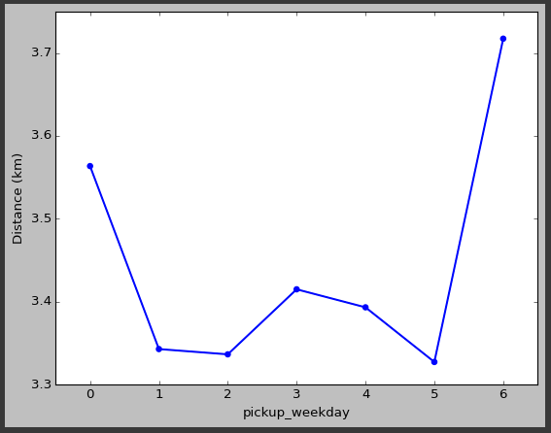
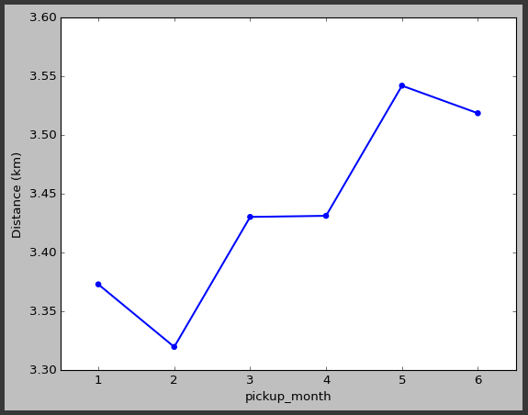
Distance
1. Distance per Weekday
So it's a fairly equal distribution with average distance metric varying around 3.5 km/h with Sunday being at the top may be due to outstation trips or night trips towards the airport.
2. Distance per Month
Here also the distribution is almost equivalent, varying mostly around 3.5 km/h with 5th month being the highest in the average distance and 2nd month being the lowest.

Slide 18
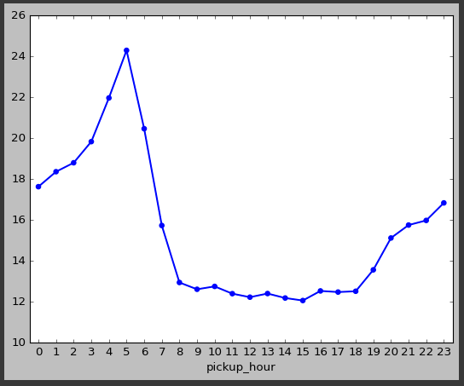
Average
1. Average Speed Per Hours
Average speed tend to increase after late evening and continues to increase gradually till the late early morning hours.
Average taxi speed is highest at 5 AM in the morning, then it declines suddenly as the office hours .
Average taxi speed is more or less same during the office hours i.e. from 8 AM till 6PM in the evening.

Slide 19
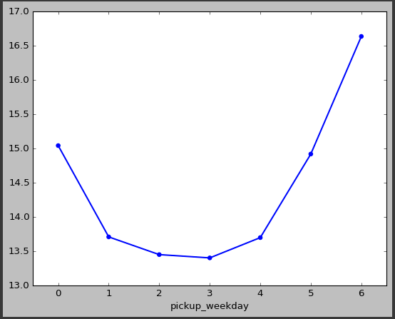
Average
2. Average Speed Per Weekday
Even on Monday the average taxi speed is shown higher which is quite surprising when it is one of the most busiest day after the weekend. There can be several possibility for such behavior Lot of customers who come back from outstation in early hours of Monday before 6 AM to attend office on time.
Early morning hours customers who come from the airports after vacation to attend office/business on time for the coming week.
There could be some more reasons as well which only a local must be aware.

Slide 20
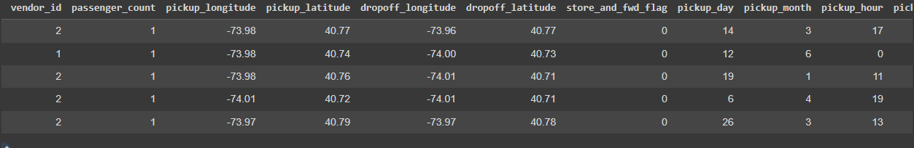
Drop Unwanted Columns
Let’s drop unwanted columns like ID, as it makes no sense and some other columns of which we have already fetched information separately.

Slide 21
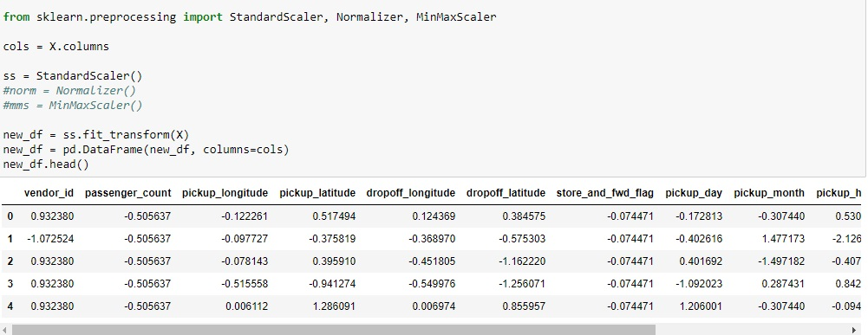
Normalizing the Dataset using Standard Scaling Technique.
Now, Why Standard Scaling ? Why not MinMax or Normalizer ?
It is because MinMax adjusts the value between 0’s and 1’s ,
which tend to work better for optimization techniques like Gradient descent and machine learning algorithms .

Slide 22
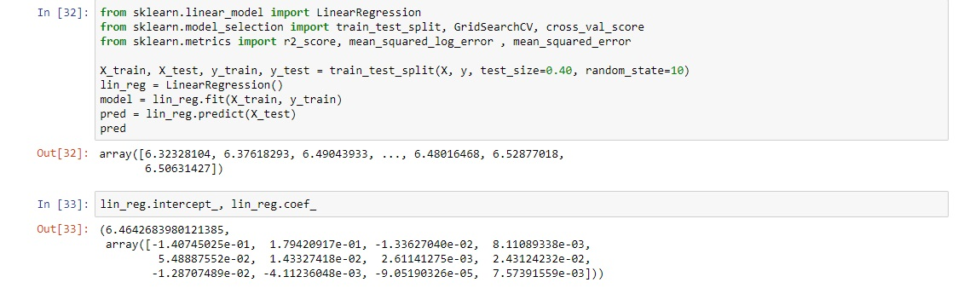
Linear Regression
To begin with , Linear Regression is a good approach, by splitting our Data into Training and Testing (30%). Our evaluation metric is RMSLE , not R-squared. We can also hyper tune our Parameters to minimize the loss (RMSLE). We will also calculate Null RMSLE , which we can set as a benchmark for our Models RMSLE.

Slide 23
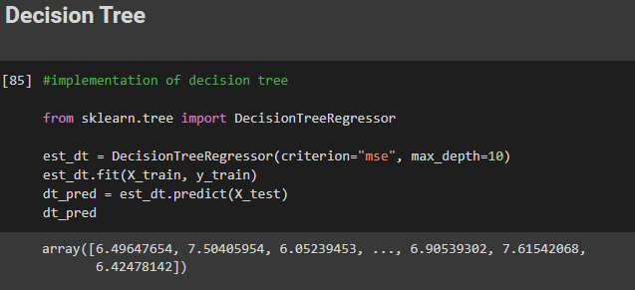
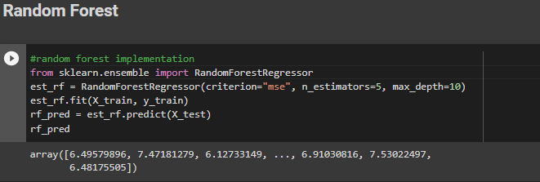
Decision Tree and Random Forest
We’ve to import Decision Tree Regressor and Random Forest Regressor and implement respective algorithms on our Data and evaluate results.

Slide 24

--- RMSLE Benchmark ---
Beat me if you can !!
Null RMSLE : 0.1146
We’ve Null RMSLE of 0.1146 which is benchmark for our Prediction model’s RMSLE. Our model’s RMSLE must be less than Null RMSLE.

Slide 25
Evaluation Results
Reference
R2-score: Usually must be between 0 and 1, towards 1 considered as good fit.
RMSLE: [Value] <= 0.1146 (Null RMSLE - A Benchmark to Achieve)
Algorithms | Training Score | Validation Score | Cross Validation Score | R2-Score | RMSLE
Linear Regression | 0.4398 | 0.4774 | 0.3453 | -0.2864 | -
Decision Tree | 0.9763 | 0.9755 | 0.9752 | 0.9749 | 0.0241
Random Forest | 0.9802 | 0.9795 | 0.9790 | 0.9789 | 0.0228

Slide 26
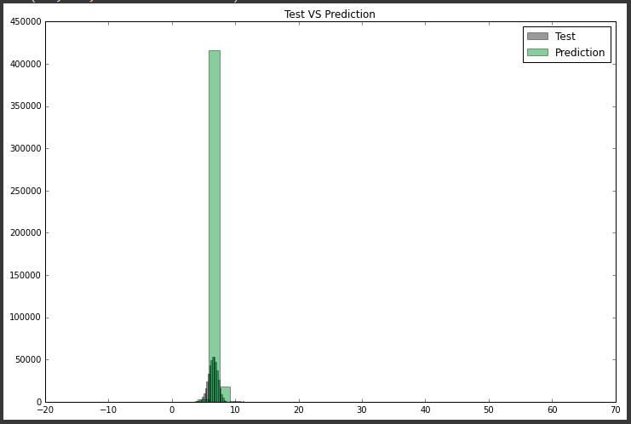
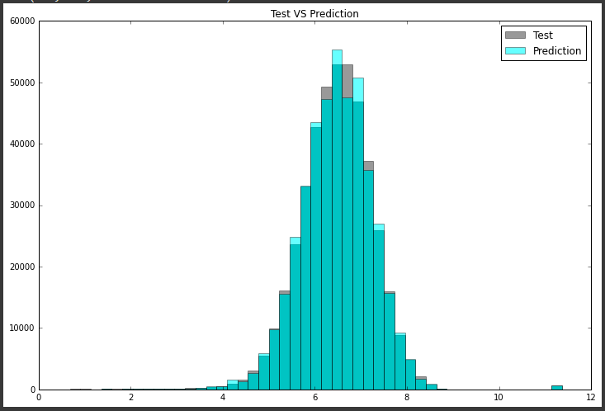
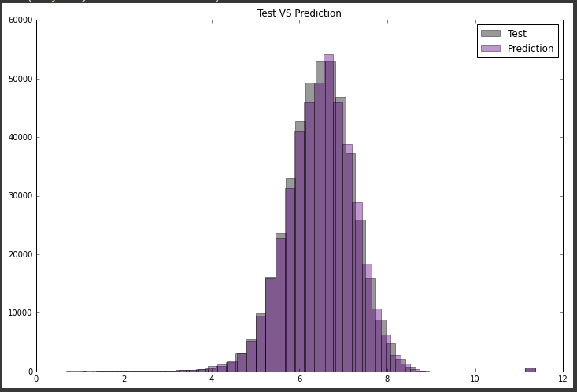
Linear Regression
Decision Tree
Visualizations show us How our model’s Predictions are close to Test Data. It is evident that Decision Tree and Random Forest are Performing well.
Random Forest

Slide 27
Approach…
The approach we could go with , just Standard Scaling Dataset and applying our Algorithms.
The approach can give us better idea of what works better for us.
This approach might take great amount of computational resources and time, it will be good if we can run this on Google’s Collab, that will eliminate huge computational stress on our system as the program will be running on Cloud.
Apply Standard Scaling on the Dataset to Normalize the values.

Slide 28
Conclusions
The most of the trips was taken by single passenger.
There are 2 vendors seems to have almost equal market share. But Vendor number 2 is evidently more famous among the population.
The most of the rides are completed between 1-10 Kms with some of the rides with distances between 10-30 kms.
The most of the trips took 0 - 30 mins to complete i.e. approx 1800 secs.
The most of the trips were done at a speed range of 10-20 km/H.
In store and forward flag indicate 99.45% trip record was in a vehicle memory before the vendor because vehicle did not connected to the server and 0.55% not stored forward trips.
Taxi pickups which starts increasing from 6AM in the morning and then declines from late evening i.e. around 8 PM.
Average trip duration is lowest at 6 AM when there is minimal traffic on the roads.

Slide 29
Conclusions
Average trip duration is generally highest around 3 PM during the busy streets.
Distance per month varying mostly around 3.5 km/h with 5th month being the highest in the average distance and 2nd month being the lowest.
We use 3 algorithm for machine learning model training but Linear Regression not performing good as compare to Decision Tree and Random Forest algorithm.
Decision Tree model and Random Forest model are good performers.

Slide 30


